Slide 2

Phillip Kujawa
Cloud Sales Specialist, CPaaS

Slide 3











Notes:
I would like to thank our partners, customers and the developers building amazing use cases leveraging our communication API's. It's truly amazing, seeing a shinning example that our customers and partners are innovating with us. I would like to thank Google and GitHub for coming out today and supporting us during this hackathon, these partners provide us the tools and capabilities that allow our customers and partners to build smarter AI based applications leveraging their API's.

Slide 4





Avaya Hackathon Stats
94 Total Attendees
API
36 In-Person Attendees
60 Remote Attendees
Notes:
The term Developer is used to describe a user (someone who is signed up on Avaya CPaaS). Although we have approximately 20,000 users on the platform, that equates to about 3,000 active applications that they've built and deployed that are leveraging Avaya CPaaS.

Slide 5


Communications Platform as a Service
APIs as a Service
Notes:
CPaaS (communications platform as a service) is a cloud-based platform that enables businesses to quickly and easily integrate communications capabilities like voice, video, and messaging into their own applications, without needing to build backend infrastructure and interfaces. This enables them to add new capabilities such as chatbots, service agents and contact centers into their customer-facing applications with minimal effort.
Simply put, we offer programmable carrier services in the form of open APIs. These APIs are building blocks. Customers can choose which building blocks they want to use and how they want those building blocks to be put together to solve a business problem.
Relatable story: In 2007, with the launch of the iPhone, smartphones became more mainstream and so did cellular data consumption. Wireless providers would send out text messages to their subscribers informing them when the subscriber has hit close to their monthly data allowance. Within this SMS, they also allowed a subscribe to reply back via SMS to add more data to their account to avoid overage fees. This in turn, would trigger an internal business process for the wireless carrier to add more data to the subscriber's account. This was an example of customer engagement via SMS. But how would other companies (who are not wireless providers) embed this type of communication channel into their workflows? This is where CPaaS helped. It allowed customers to embed communication channels such as SMS into their business workflows without requiring to deploy complex, expensive infrastructure, they simply consume the service via API.
Importance of CPaaS and communication enabling applications.

Slide 6

Why Avaya OneCloud CPaaS?
Native Integration with other Avaya Services
Free Development Tools
Smart Burstable SIP Services
Accessible APIs
Competitive Rates
Support Inclusive
Code Options
Burstable Redundancy
Notes:
Native Integration with other Avaya Services; Avaya CPaaS is already natively supported by other Avaya services including Experience Portal, Proactive Outreach Manager, Officelinx, Breeze and ANS.
Free Development Tools; Accessible right from the website, users can leverage Workflow Designer, InboundXML and REST APIs for free to use as development tools – the only cost is consumption of the APIs. If customers use Workflow Designer,
Smart Burstable SIP Services – Avaya CPaaS offers smart burstable SIP services which are not limited to number of trunks. We support provisioning local, toll free long codes and short codes.
Accessible APIs; Avaya CPaaS APIs are fully documented and we offer quick start guides, sample code and libraries to get you started easily and quickly.
Competitive Rates; Our rates for each microservice are competitive, often more competitive than the "big guys". There are no licensing fees with Avaya CpaaS, strictly consumption.
Support Inclusive; Avaya CPaaS offers support to all CPaaS customers, regardless of consumption volume. There are no monthly or annual fees associated with standard support.
Code Options; Avaya CPaaS APIs are open, REST based, allowing customers to choose to develop in virtually any language or environment (I.e. PHP, Java, JS.node, Python, etc.)
Burstable Redundancy; Avaya CPaaS is geo-graphically redundant and leverages some of the most powerful containerization systems to ensure scalability, reliability and performance.

Slide 7




API Overview
Avaya OneCloud CPaaS
Messaging
Build intelligent, reliable messaging apps with Avaya OneCloud CPaaS API's for a powerful way to engage customers.
Voice
One simple API enables you to add voice and calling features to your web or mobile apps.
Carrier Services
Gain valuable insights into the origin of your callers to help you nurture sales leads or prevent fraud and spam.
Phone Numbers
Buy local and toll-free numbers and short codes from Avaya OneCloud CPaaS fully online and with no set-up required.

Slide 8
Avaya OneCloud CPaaS – Quick Stats
~12,000
Active Developers
~3,000
Active Applications
~50 different microservices
40M voice minutes a month
50 SMS a month
Phone Number Support for 54 countries worldwide
Notes:
The term Developer is used to describe a user (someone who is signed up on Avaya CPaaS). Although we have approximately 20,000 users on the platform, that equates to about 3,000 active applications that they've built and deployed that are leveraging Avaya CPaaS.

Slide 9
Messaging Applications
Use Cases
SMS/MMS
Automatically exchange text messages with your customers. And you can let them respond, encouraging interaction and a great user experience.
IVR with SMS
Build an IVR system with an SMS twist. Enable customers to interact with your team and get information on your products or services via text messaging.
Customer Notifications
Provide automated text messages to notify customers of important information and give them the ability to easily reply via SMS or phone call.
Two-Factor Authentication
Introduce an additional layer of security to your apps by enabling SMS verification codes to be sent to customers during the login process.
Polling + Surveying
Obtain valuable insights by deploying automated polls and surveys to gauge customer attitudes and opinions.
Click-to-SMS
Provide the ability to simply click or tap to send an SMS from your app or service, and engage your customers faster than ever before.

Slide 10
Voice Applications
Use Cases
IVR
Customers can navigate to information and relevant points of contact, simply by calling into your organization's main line and navigating your automated Interactive Voice Response (IVR) menu.
Conferencing
Host audio conference calls with multiple participants from anywhere.
Call Tracking
Track call data and gain better insights into your customers and campaigns.
Click-to-Call
Enable the dialing of phone numbers in your web or mobile apps with a simple, click-to-call action.
Call Recording + Transcription
Automatically record incoming and/or outgoing calls and then have them transcribed into text.
Call Unmasking
Unmask incoming phone calls by revealing blocked or unknown numbers.

Slide 11
Phone Numbers Avaya OneCloud CPaaS
Local Phone Numbers:
Regardless of where you’re located, you can talk to your customers with a local identity.
Toll-Free:
We support toll-free numbers in 40+ countries, starting as low as $2/month. You can SMS-enable your existing, publicly available numbers and discover a new way to engage your customers. And with no volume restrictions, you can send as many messages or start as many voice calls as you need to run your business.
Shared Short Codes:
Lease existing, pre-approved short codes through Avaya Cloud CPaaS. Use them to schedule SMS and MMS in bulk from one number, so you can engage your customers by sending multiple messages per second.
Dedicated Short Codes:
Let us do the hard work! We’ll help you through the process of obtaining and deploying dedicated short codes. Use them for branding purposes or to enable higher throughput for your messaging campaigns.

Slide 12
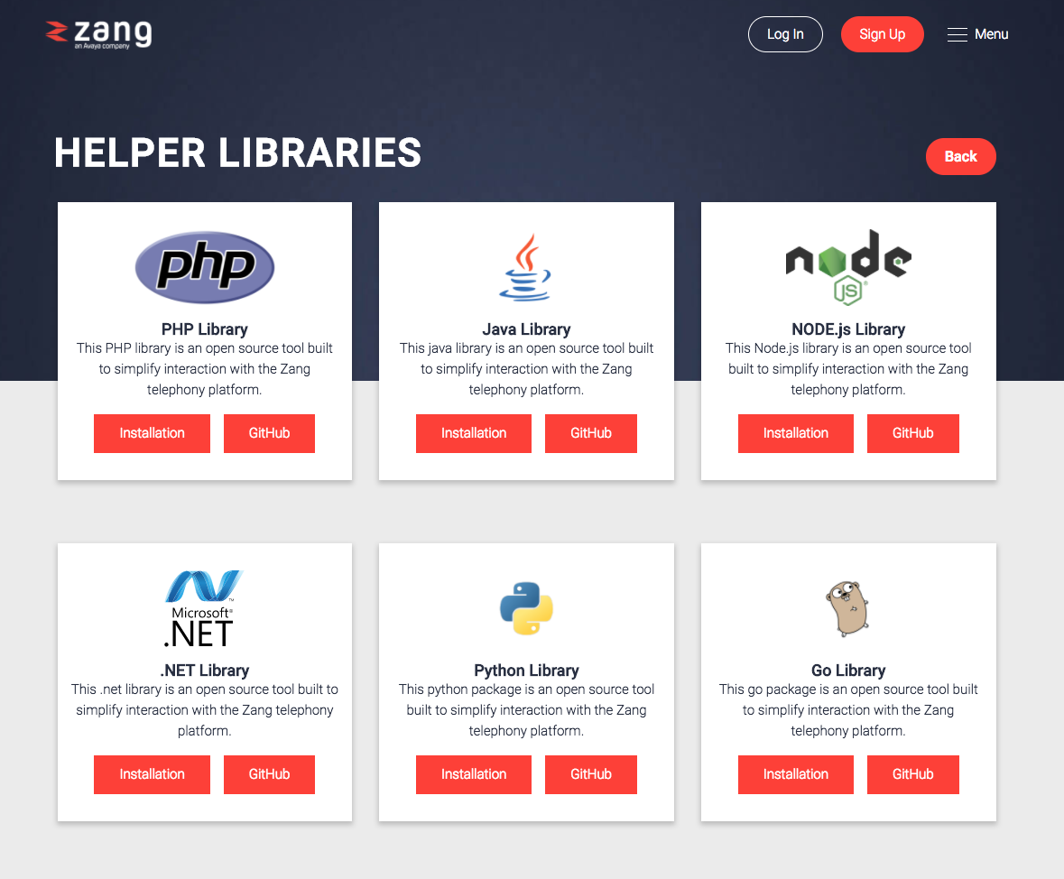
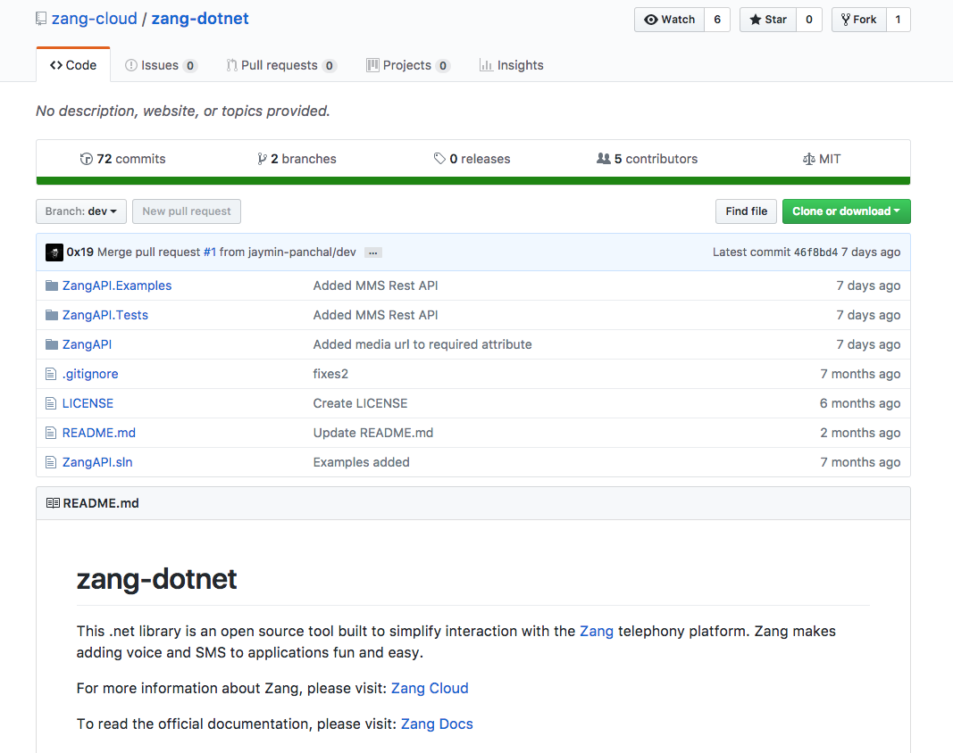
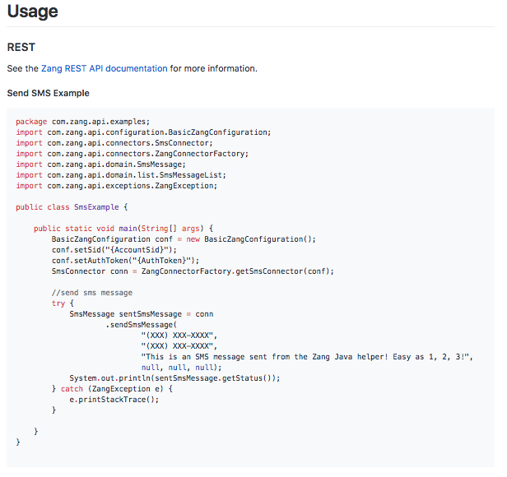
RESTful API Libraries
Avaya OneCloud CPaaS

Slide 13
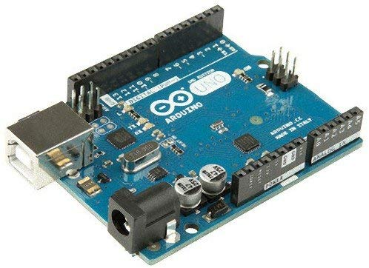
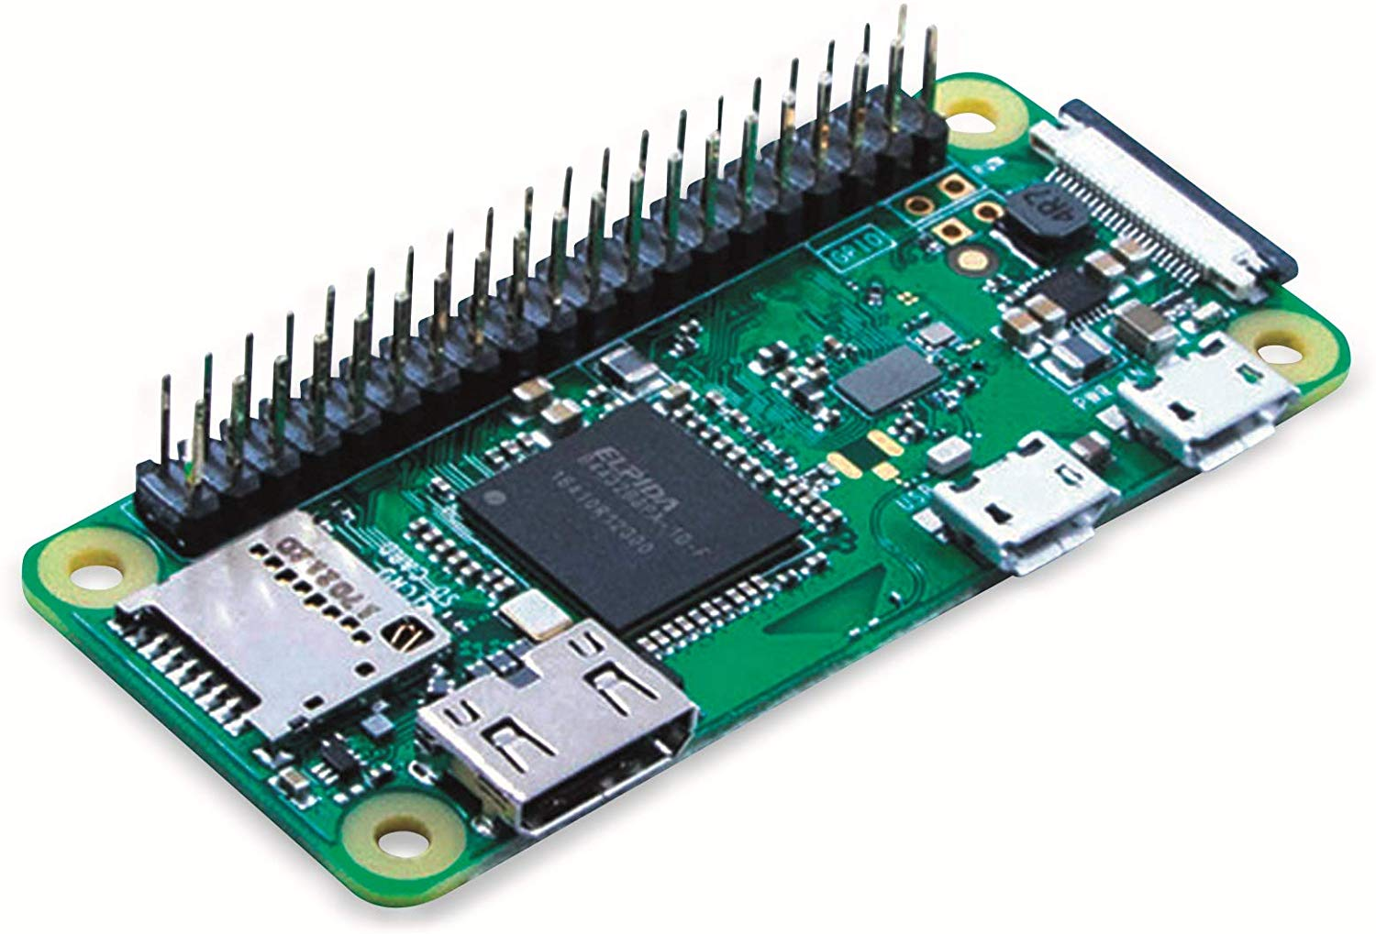
Internet Of Things (IoT) Avaya OneCloud CPaaS
Build communication enabled applications using IoT devices:
Smart Doorbell where a button press makes a SIP call, sends an SMS or sends a WhatsApp message using CPaaS
Soil Moisture Sensor that sends a text message to let you know when your plants need watering
Temperature sensor inside of a temperature controlled laboratory, send a text message with warnings.

Slide 14
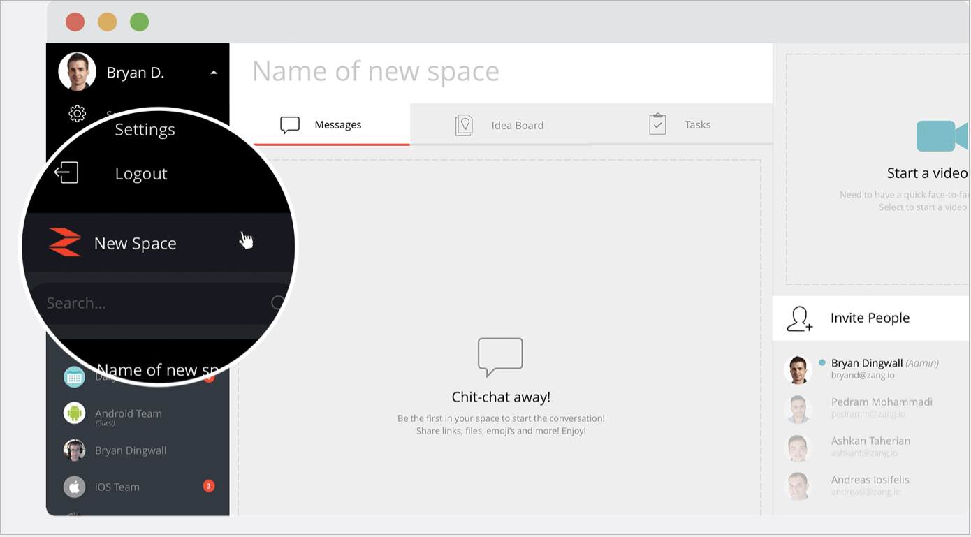
Spaces API Avaya OneCloud CPaaS
Open RESTful API Documentation Available at: https://spaces.zang.io/developers/docs/
Various protocols used to interface with Avaya Spaces:
Communication: Socket.io websocket library used for real-time communication (sending and receiving messages from a space).
Interfaces: RESTful interface using JSON payload, used to communicate with third party interfaces

Slide 15
Avaya OneCloud CPaaS Workshop
How to get started with our libraries
How to purchase a phone numbers
Building your first Avaya OneCloud CPaaS App!
Workshop will be an hour after the kickoff presentation

Slide 16

GitHub Resources:
Avaya Engage 2020 Hackathon Repository - https://github.com/Avaya-Hackathon-2020-TADHack-Phoenix
GitHub Learning Lab - https://lab.github.com/
Courses listed are available for free with a GitHub User Account
GitHub Blog - Introducing GitHub Learning Lab - https://github.blog/2018-04-19-introducing-github-learning-lab/
GitHub Whitepapers - https://resources.github.com/whitepapers/
GitHub Webcasts - https://resources.github.com/webcasts/
GitHub Videos - https://resources.github.com/videos/
GitHub Guides - https://guides.github.com/
GitHub Flow packets available

Slide 17

Avaya OneCloud CPaaS Resources
CPaaS REST Documentation:
https://docs.avayacloud.com/aspx/rest#overview
CPaaS InboundXML Documentation:
https://docs.avayacloud.com/aspx/inboundxml
CPaaS GitHub Repository:
https://github.com/zang-cloud
Additional CPaaS Resources
https://resources.avayacloud.com/aspx/Avaya_CPaaS
Spaces API Documentation:
https://spaces.zang.io/developers/docs/
SIGN UP AT: http://www.avayacloud.com

Slide 18
Thank you.

